Slide 1
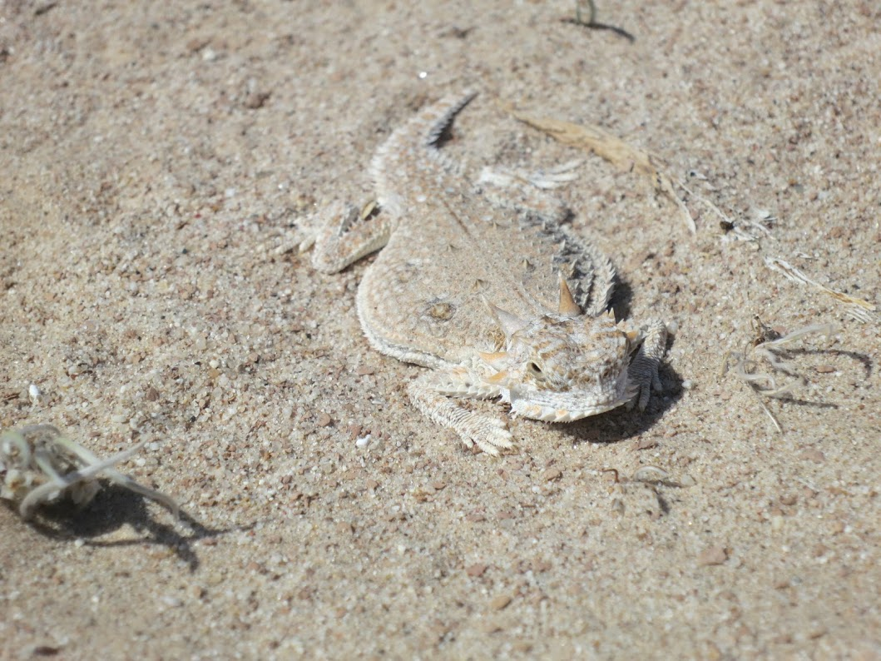
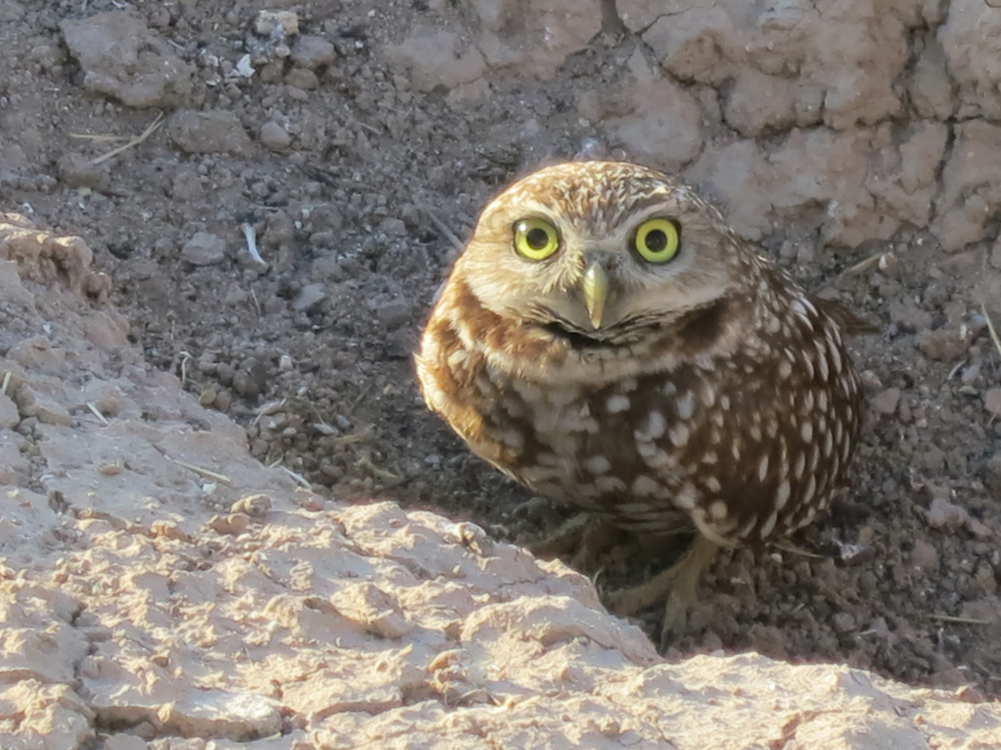
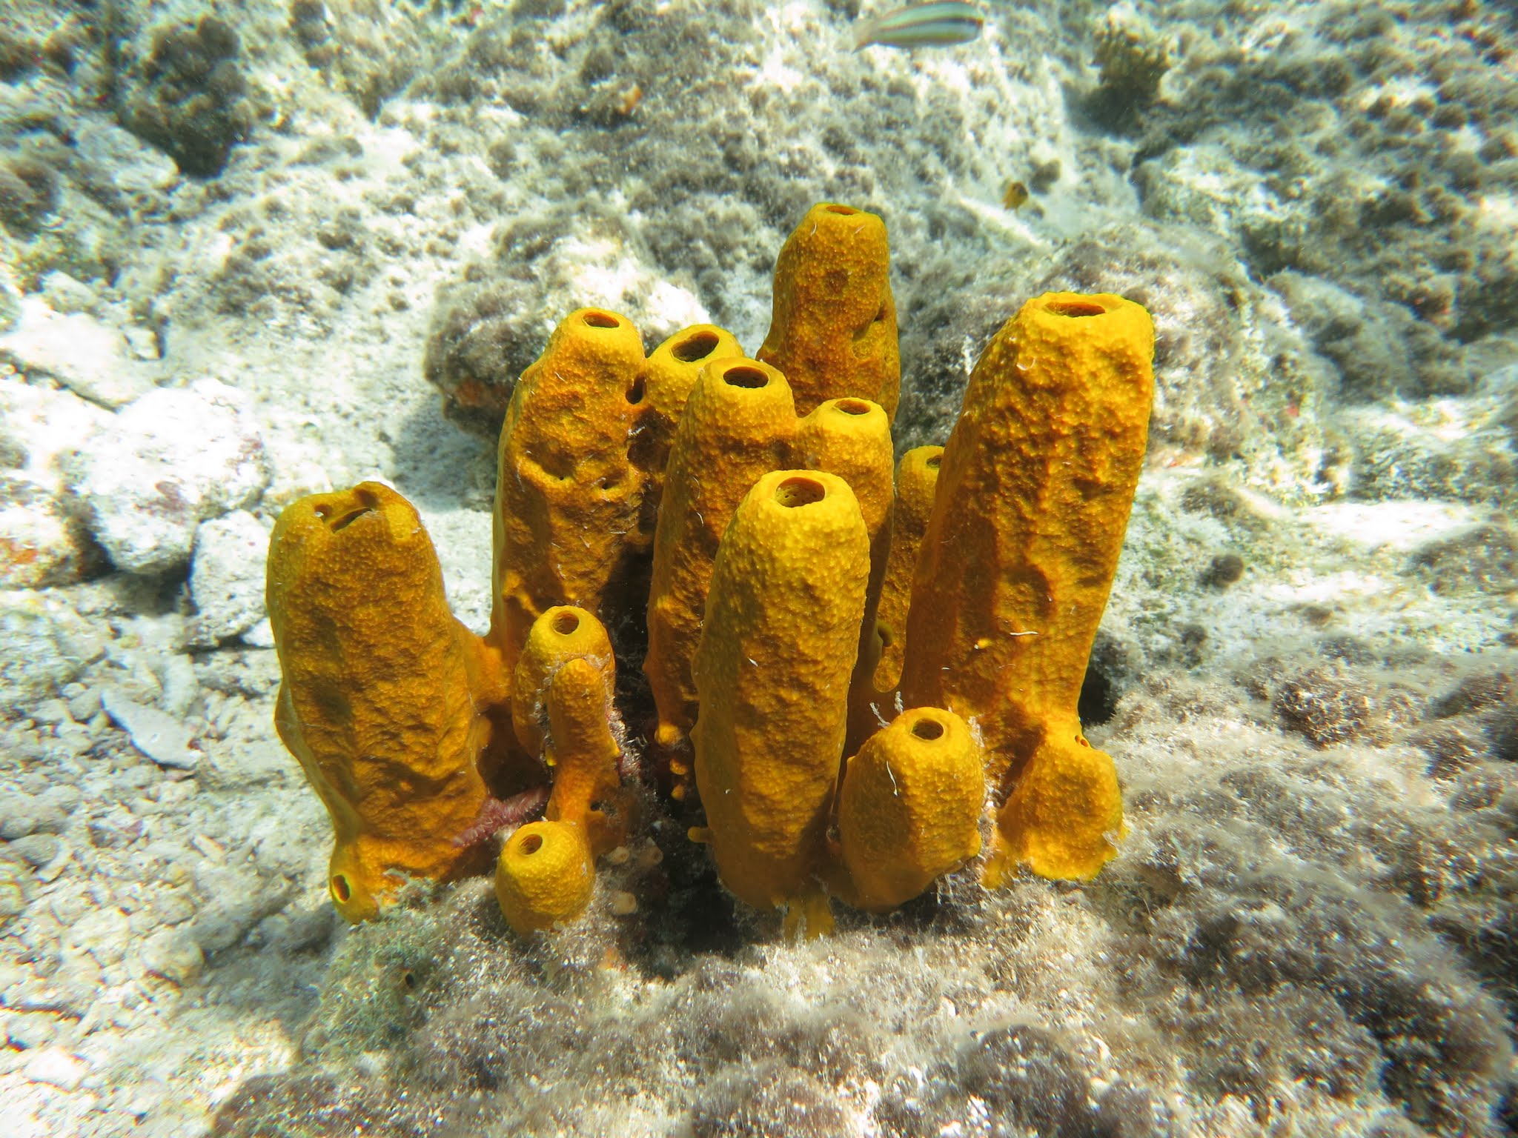
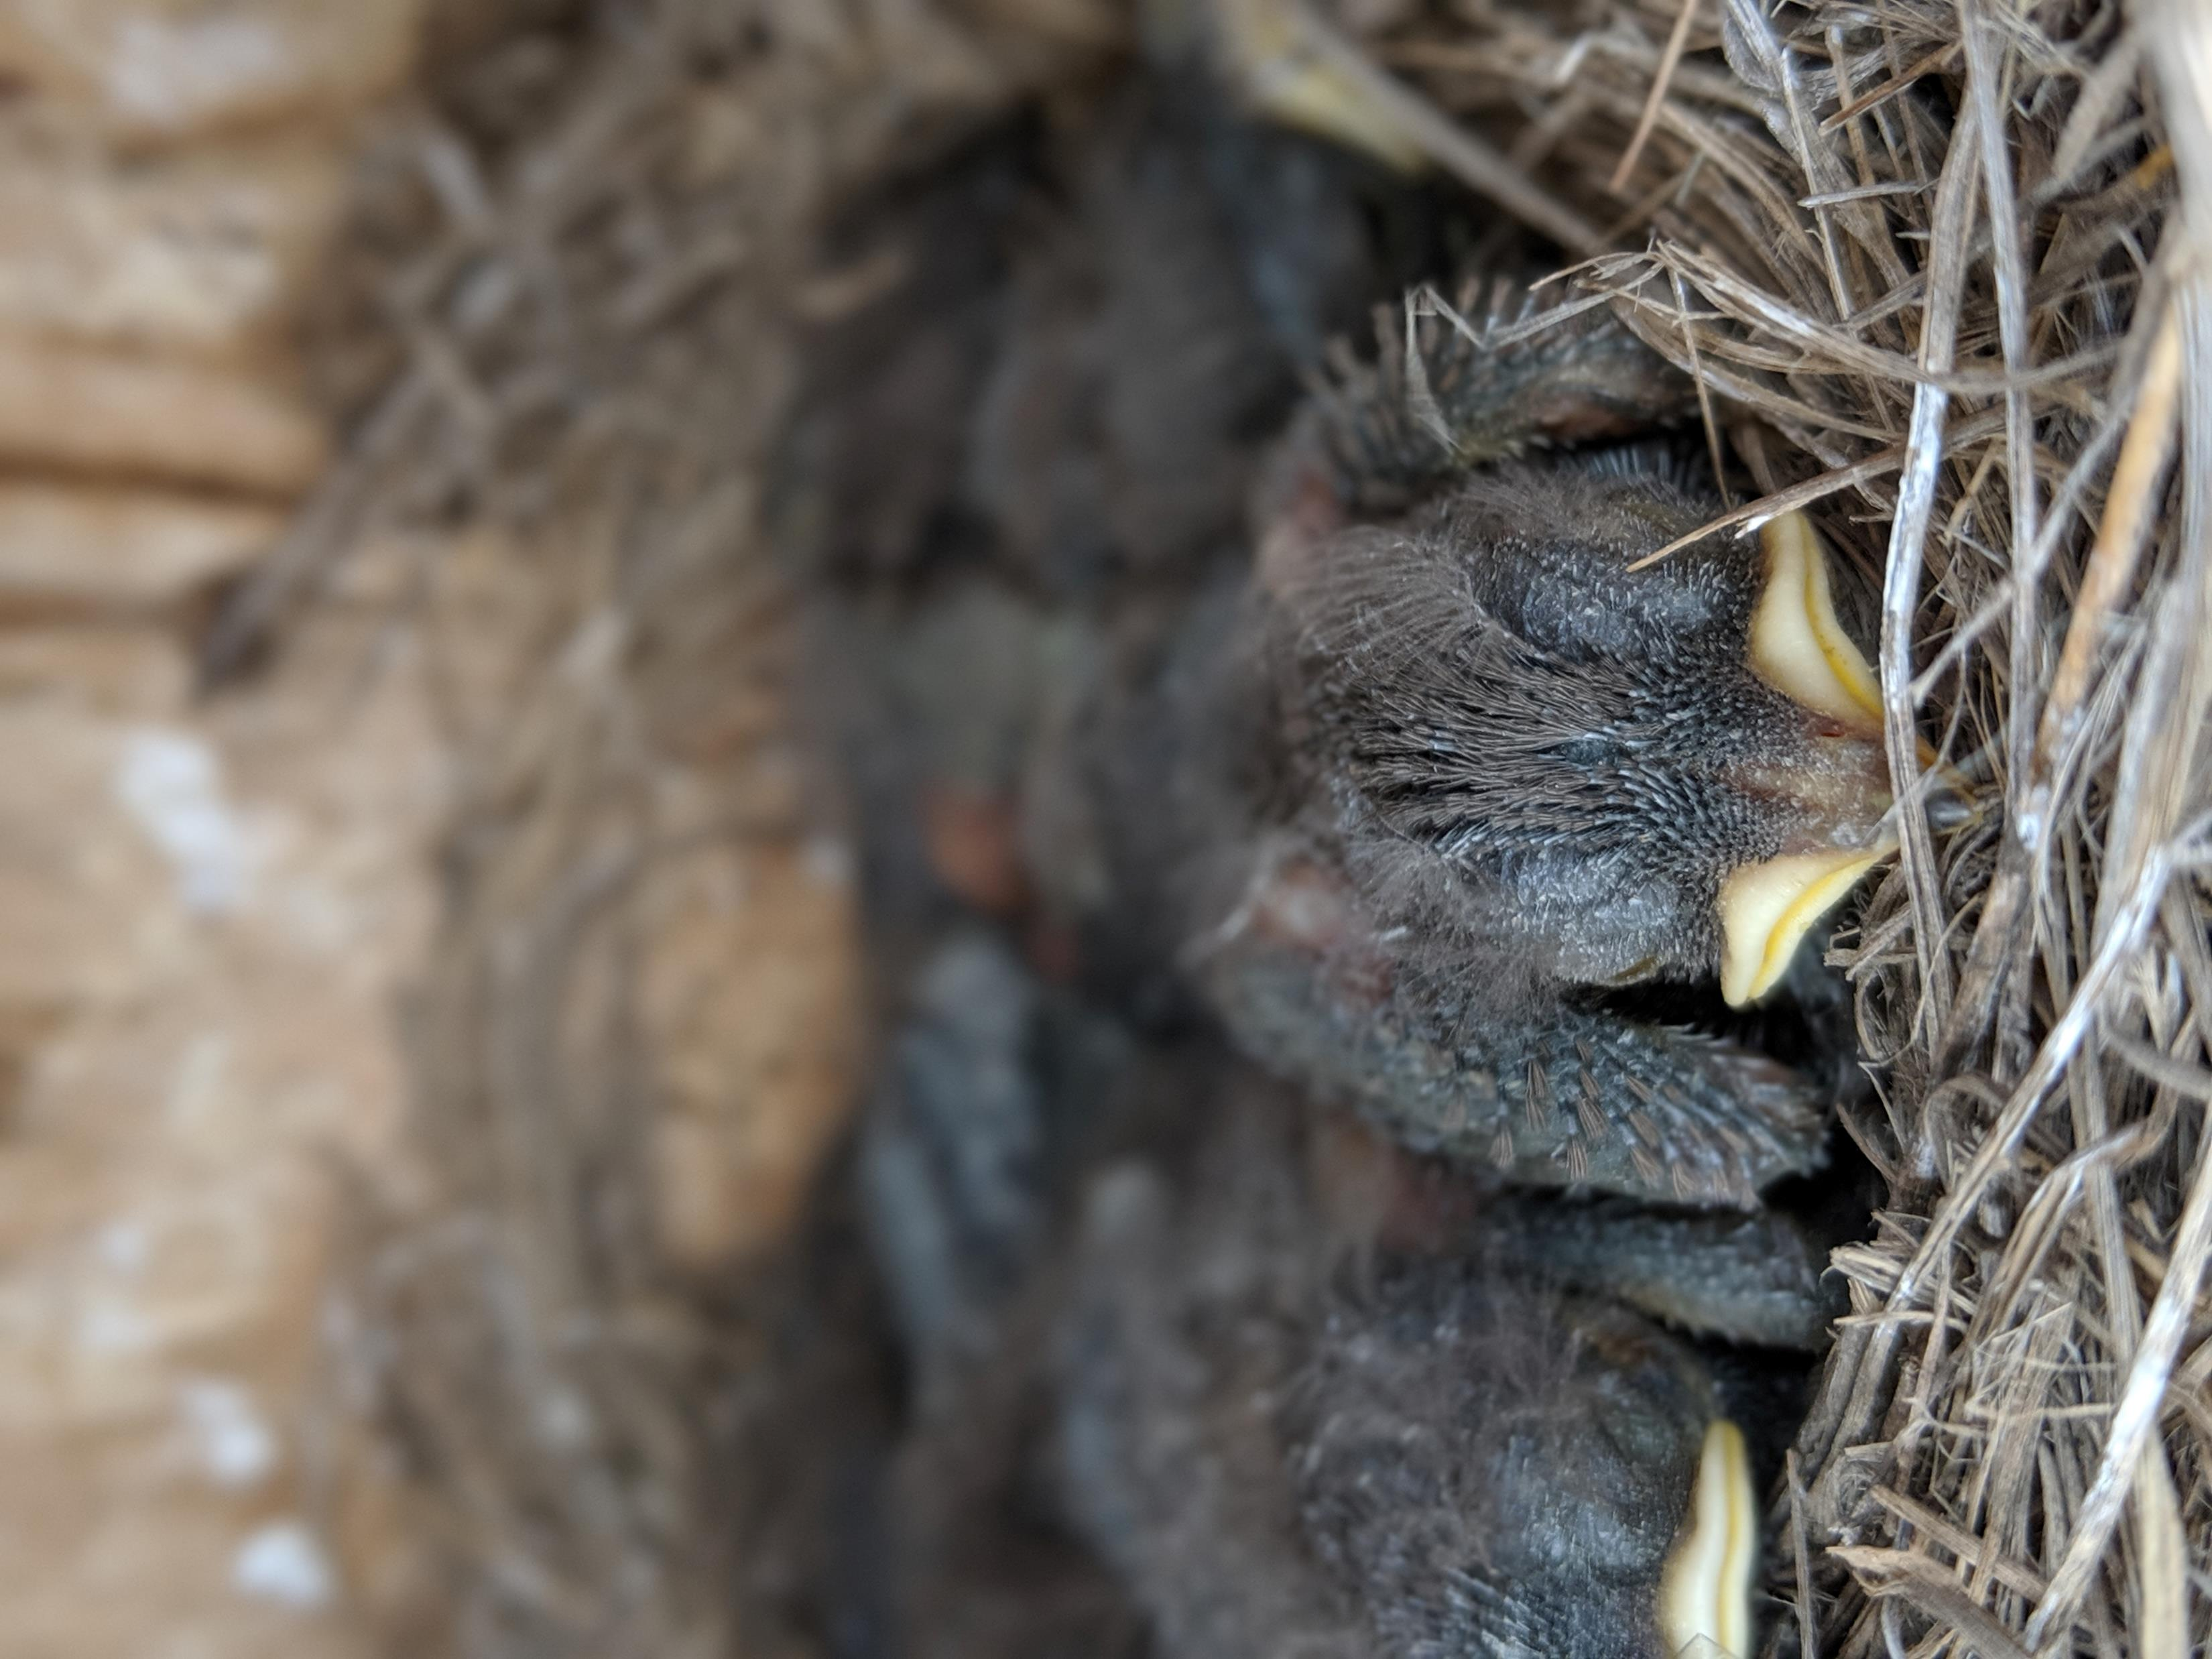
Introduction to Occupancy Modeling
CECAM, Mérida, Yucatán
31 Aug – 1 Sep, 2019
Allison Pierce, Scott Yanco, Michael Wunder, PhD

Slide 2
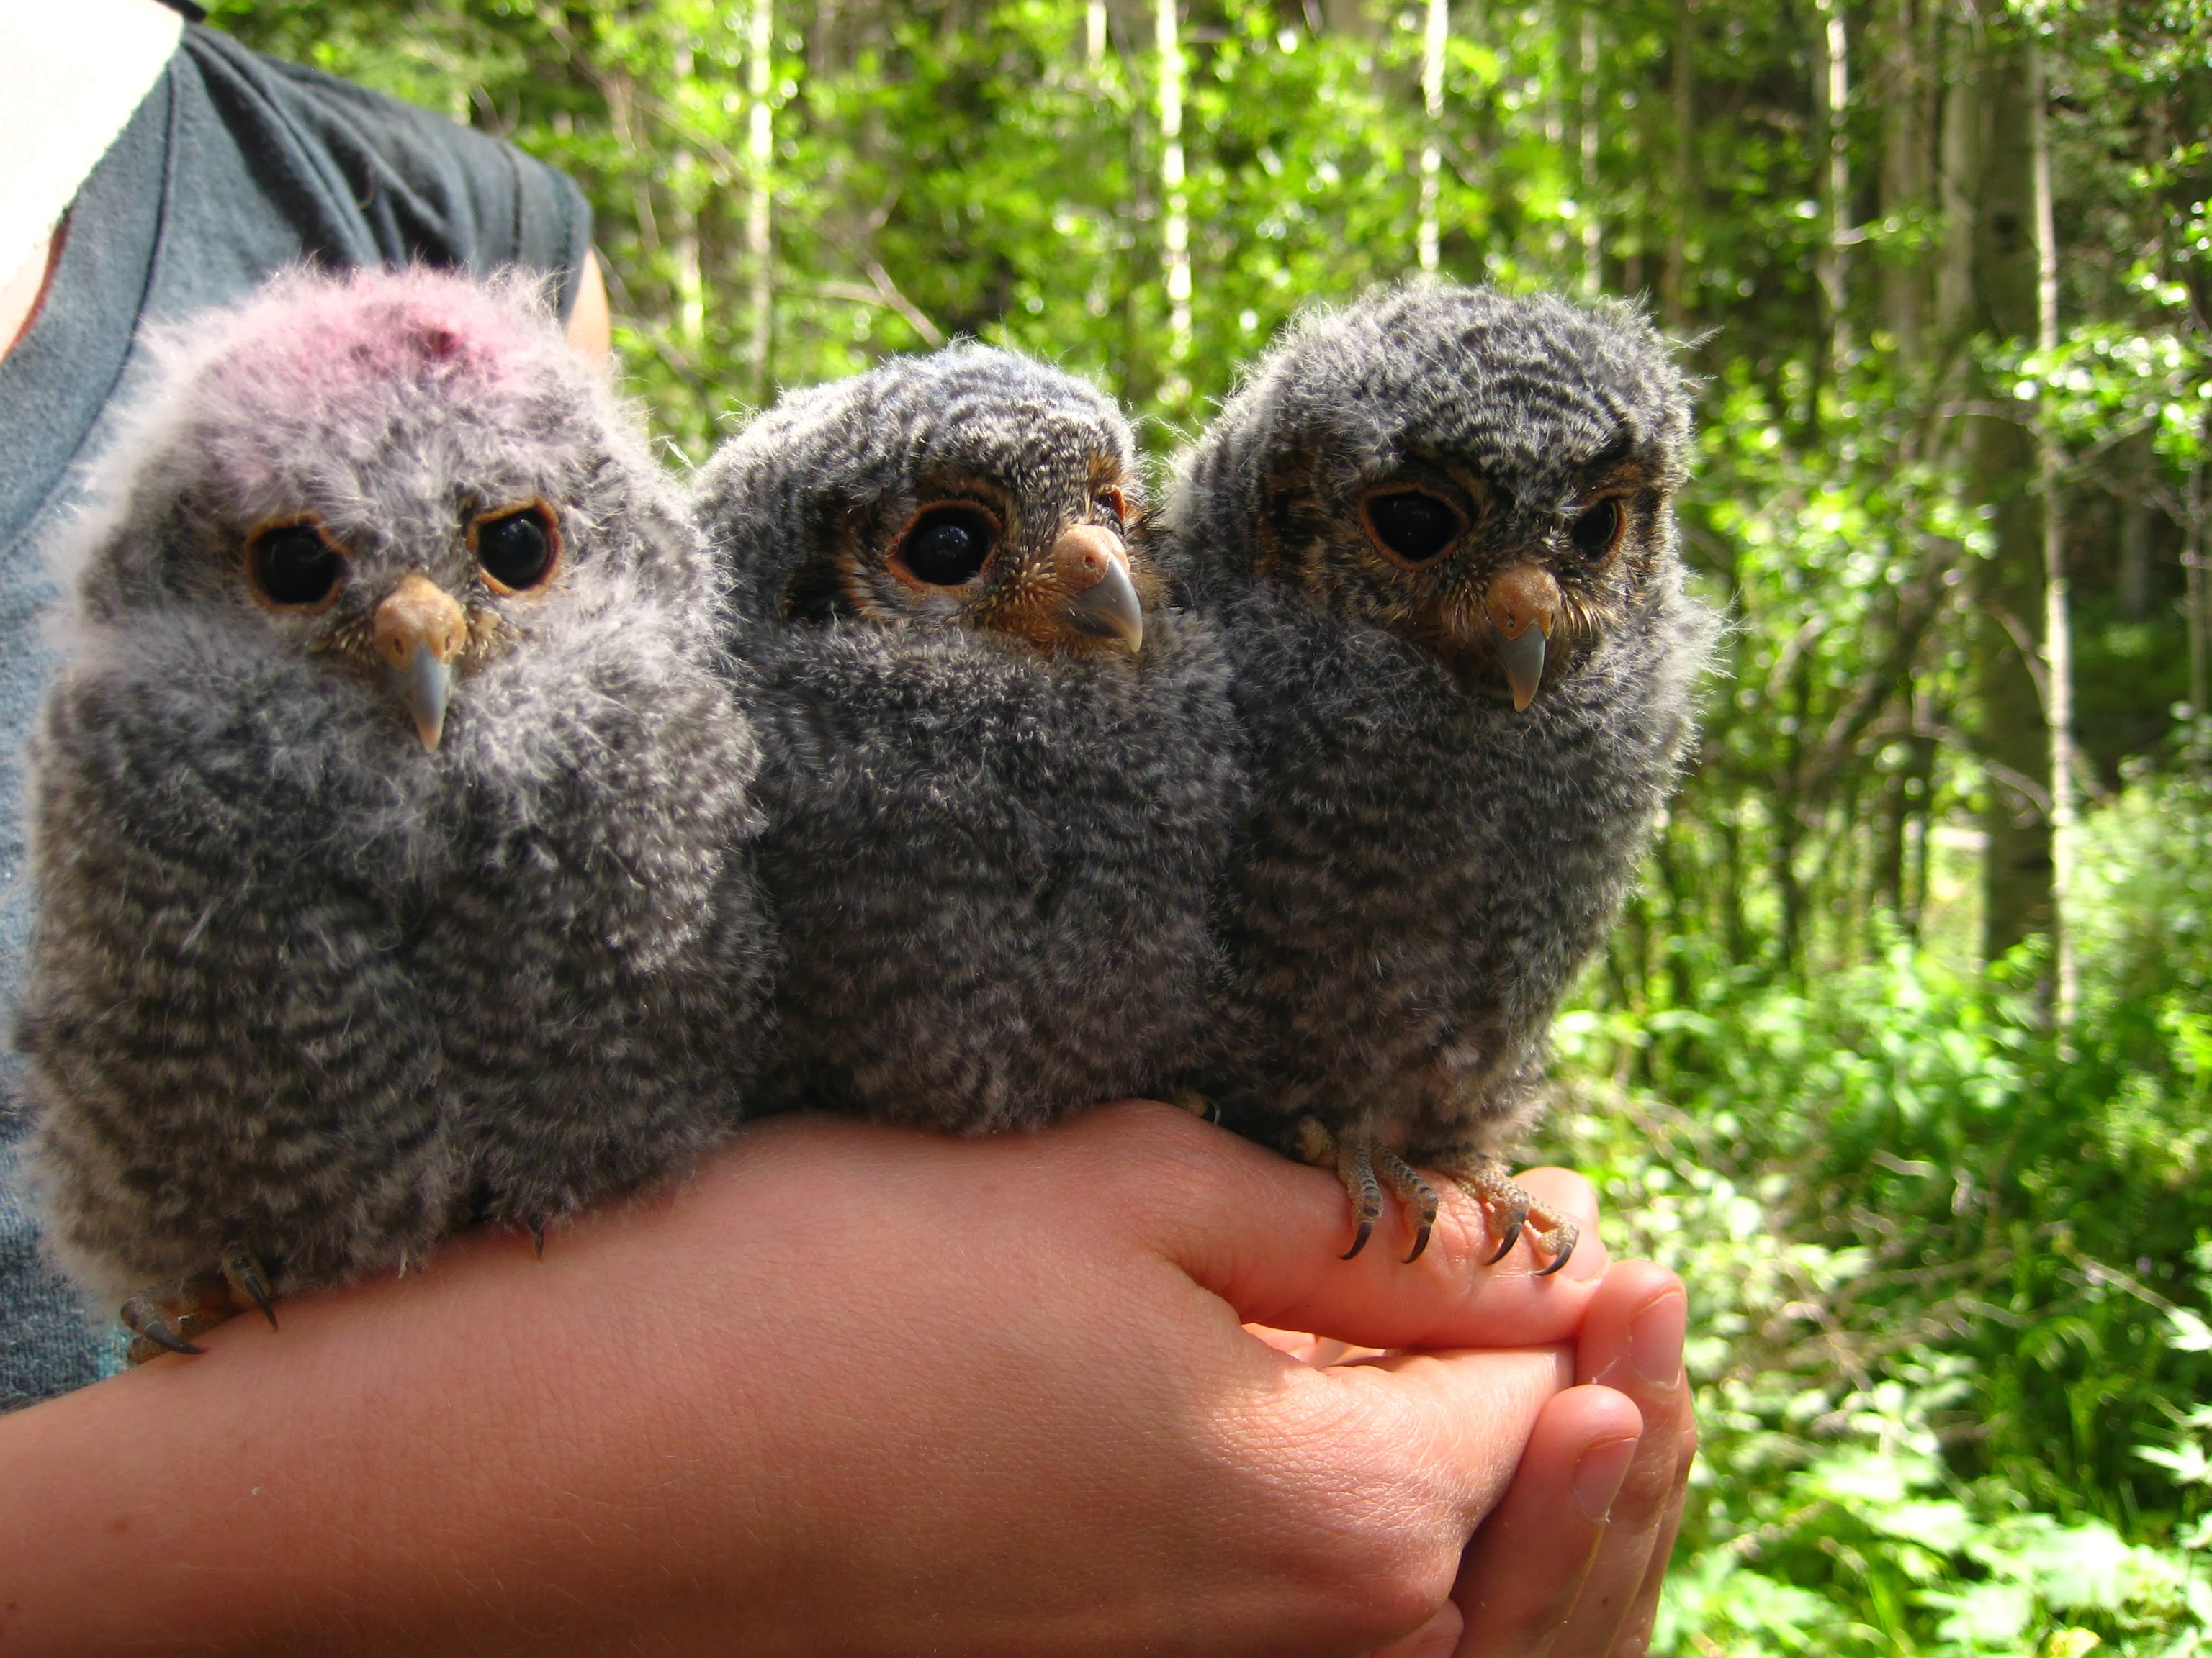
Instructors:
Allison Pierce
Scott Yanco
Michael Wunder, PhD
Introduce yourselves:
Research interests
Comfort with R
Experience with occupancy modeling (or mark-recapture)
Why are you here?
Course website: https://syanco.github.io/CECAM_2019_Occupancy_Workshop/
Coding sessions – how to ask for help!
Outline, breaks, questions, etc.

Slide 3
If you don’t have R installed yet:
R:
Download R (free) at:
https://cran.r-project.org/
RStudio:
Download RStudio (free) at:
https://www.rstudio.com/products/rstudio/download/

Slide 4
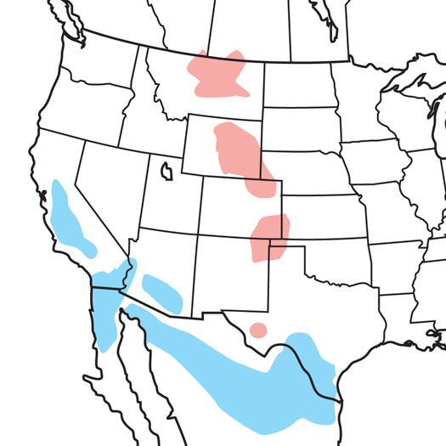
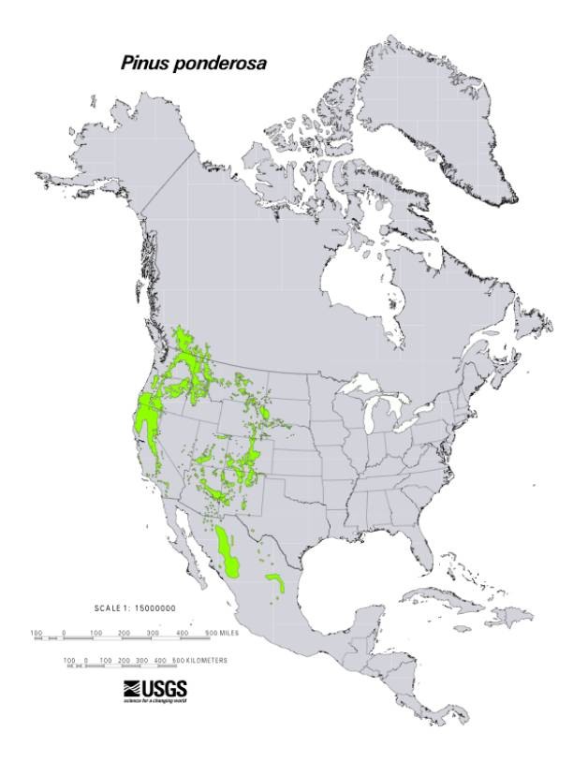
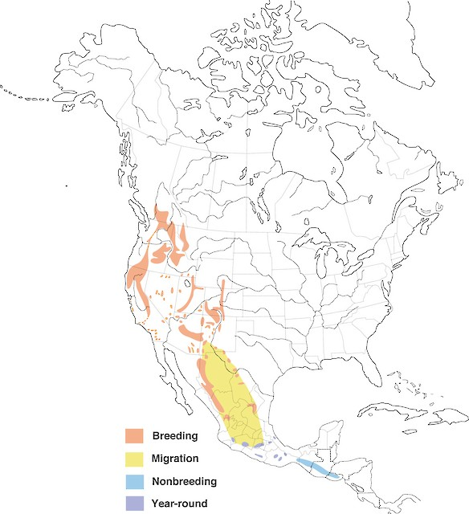
Why use occupancy modeling?
audubon.org
Birds of North America
Notes:
Fundamental question in ecology: where are organisms distributed on the landscape? Where are they and where aren’t they? And why do we find animals where we do?

Slide 5
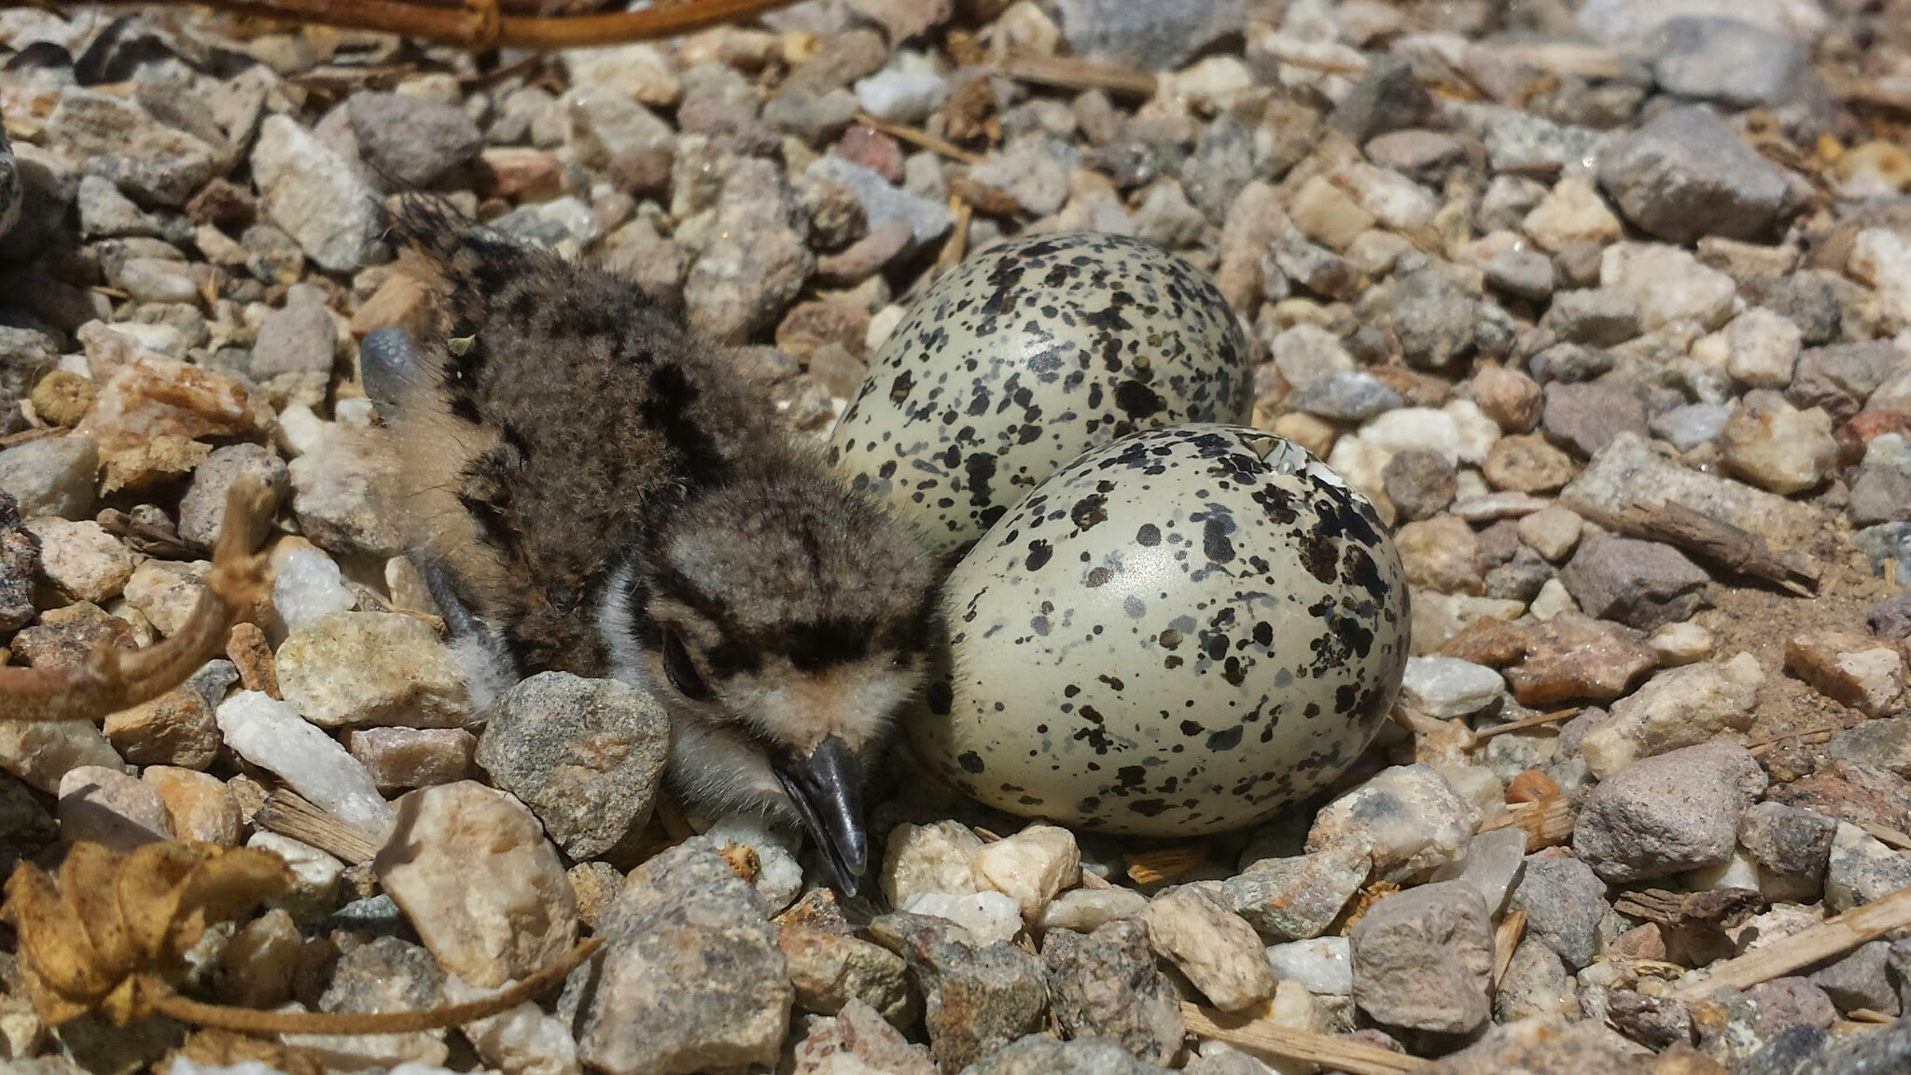

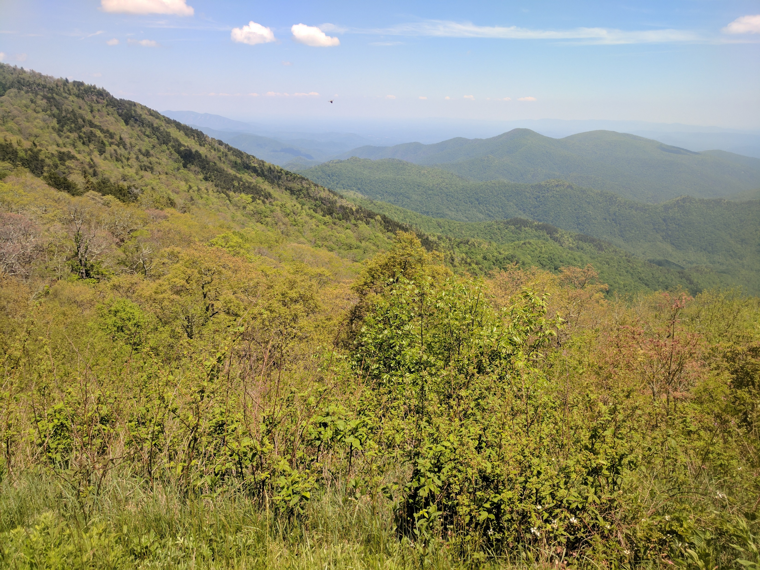
Imperfect Detection
photo credit: Michael Ciaglo
Notes:
Imperfect detection can arise lots of ways: cryptic species, difficult-to-search habitat, variance in surveyor skill…
Others might be weather, phenology, behavior, etc.
We’ll see how occu is a way to estimate both occupancy proportion/probability and probability of detection AT THE SAME TIME

Slide 6
Occupancy can tell us…
“Population”: total area of interest
Sample of sites from Population
Site-level covariates
ψ: probability of occupancy
Multiple visits per site
Site-visit-level covariates
p: probability of detection

